Slide 1
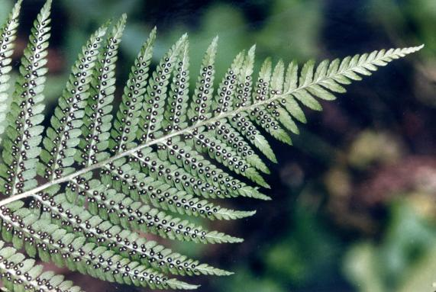
- Biomimicry – A Problem Solving Tool
By:
For:
Date:
Notes:
This presentation was designed to help municipal officials and staff address the myriad challenges posed by a changing climate. It was developed by a team studying biomimicry under the direction of EPA Region 8’s biomimicry expert, Marie Zanowick. The team was comprised of an interdisciplinary team, including the following: [see next slide]

Slide 2
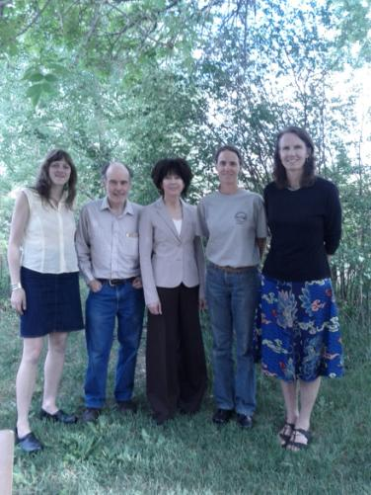
Team Adaptors
Sarah Dawn Haynes
Possibility Cartographer
University of Colorado
Kirk Mills
SARA/Sustainability Program, Division of Environmental Health & Sustainability CO Dept. of Public Health & Environment
Laura Farris
Climate Change Coordinator US EPA Region 8
Lynne Sullivan
Interpretive Naturalist, City of Boulder’s Open Space and Mountain Parks Dept.
Margot Smit
Mediator and Facilitator
Biomimicry Workshop 2012
Notes:
Interdisciplinary teams are critical for bringing in creative and divergent perspectives and skill sets for the most productive Biomimicry process, which includes the following steps:

Slide 3
This Presentation will …
Discuss how nature can be our mentor
Review the evolutionary history of life on Earth
Explain the methodology of Biomimicry
Give examples of how nature solves problems
Show how people have applied nature’s strategies
Notes:
Today’s power point will be about Biomimicry used as a problem solving tool and we’ll cover the following topics:
[Read the list]

Slide 4
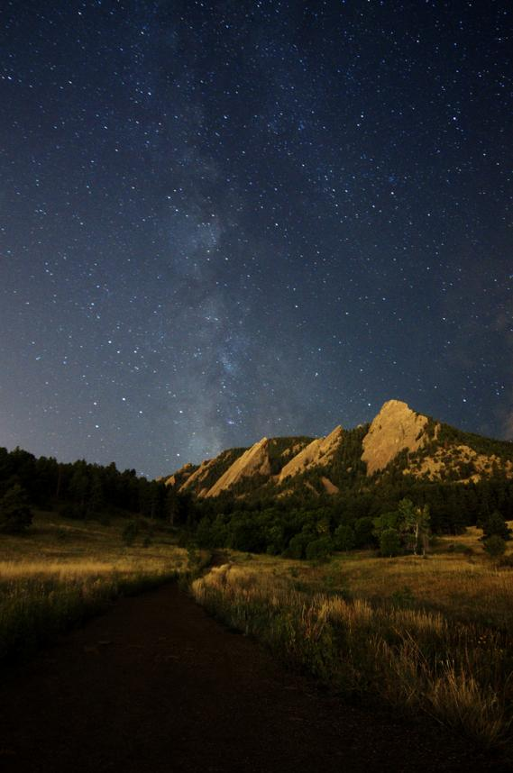
Notes:
Biomimicry is quite simply, a return to a deep knowing about our natural environment. It is a search for patterns, successful survival strategies and relationships in nature. Understanding this we can “consciously emulate nature’s genius” as we work to solve problems that we face in our cities, our infrastructure and lifestyle choices, enabling us to take critical steps towards being sustainable. Today’s focus will revolve around how we might modify our systems to deal with the local affects of climate change

Slide 5
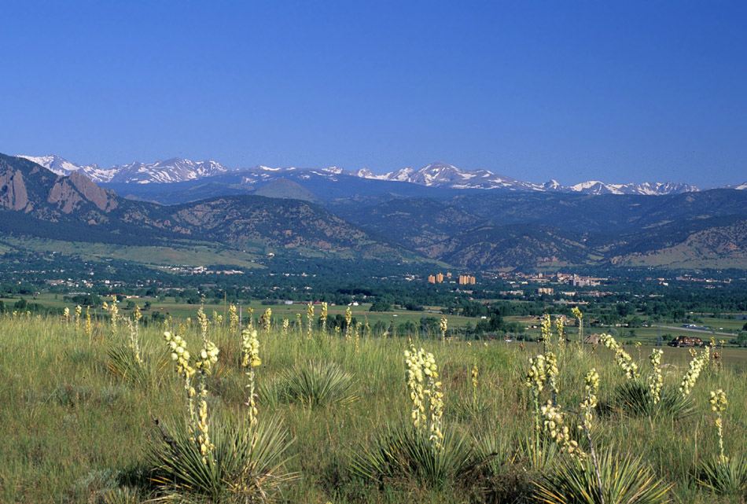
Notes:
We have tremendous opportunity to gain insight right outside our doors.
Life has been on this planet for 3.8 billion years, doing everything we want to do, sustainably, without damage to the planet, or its future.
If we can reconnect with nature, with an open mind and a wide sense of wonder we too can live sustainable, cooperative, lives while being good stewards to all other life on this planet.

Slide 6
Notes:
The earth is home to anywhere from 8 – 30 million species, some estimate as many as 100 million species.
Their ability to survive and adapt has stood the test of time. These are our mentors, most of them arrived here long before we did.
It is helpful to remember the progression of living systems as they evolved on this planet, but a 3.8 billion year time frame is difficult to grasp. So we will compress this down to a single calendar year, to demonstrate the relative arrival times of different kinds of life here on the earth.

Slide 7
Make this slide black
Notes:
If we make Jan 1st represent the very beginning stirrings of life on Earth, we would encounter a somewhat mysterious primordial soup which continues simmering for almost 2 months, until

Slide 8
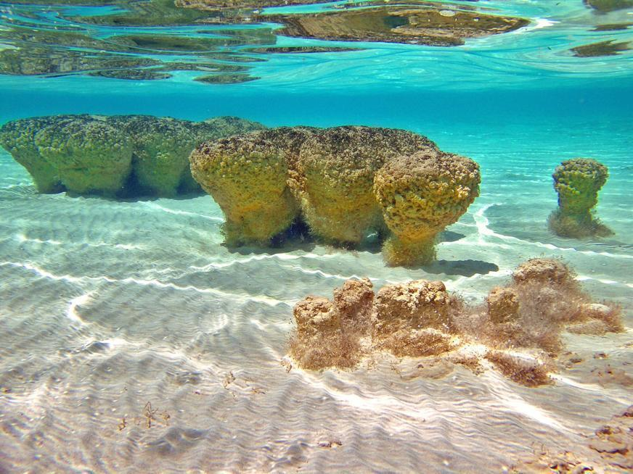
February 25th recognizable life
Notes:
By Feb 25th what we would actually call life is born. Seen in some of the earliest bacteria, like these stromatolites, which actually can still be found along the Australia coast, and

Slide 9
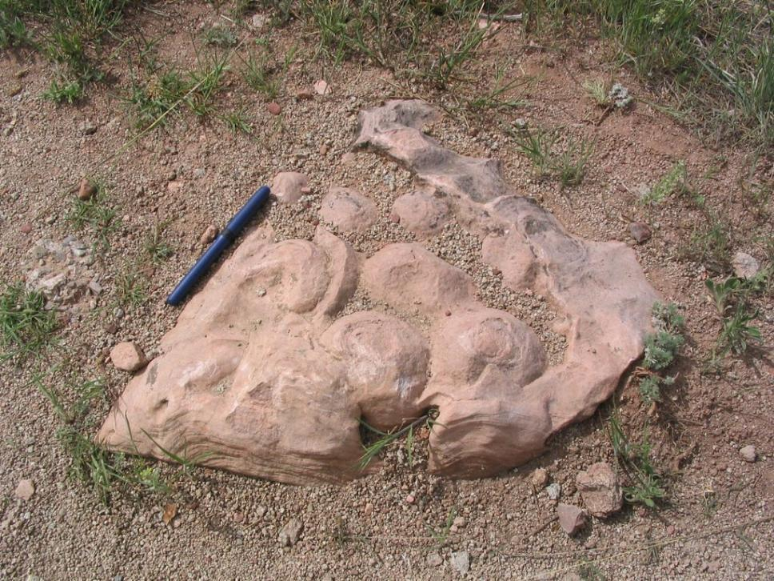
Notes:
and we have fossil stromatolites behind NCAR, just off the Mallory Cave trail. Hinting at how the very land under our feet changes radically over time, challenging the beings to thrive or perish.
Pic stromatolite from Heil Ranch
---------------------------------
Fossil from NCAR
There are good photos on the website to Sharks Bay, Australia. Google it and check out the images. It is a park. You can use the DMNS Lykins Formation. I got permission for my powerpoint program. You can always try for permission for an educational program. I have never been turned down. I have some pictures of stromatolites from Heil.

Slide 10
March 28th photosynthesis
Notes:
In March, organisms develop the ability to photosynthesize and begin to oxygenate the atmosphere - poison to some, life giving to those who can adapt.

Slide 11
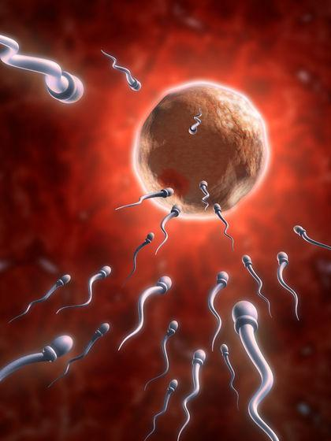
September 17th sexual reproduction
Notes:
It took until September, of our compressed life’s evolution year, for sex to burst onto the scene. With it the diversity of life explodes.
With genes mixing, dancing to the tune of love in the air, the earth births an explosion of life forms,
with a renewed capacity to evolve survival strategies.

Slide 12
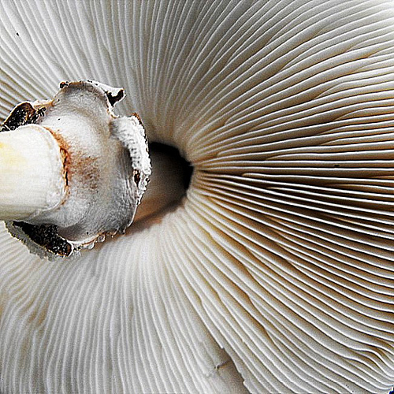
November 15th colonization of the land
Notes:
One of the first organisms to colonize the land are the mushrooms, arriving on the nearly virgin soil on Nov 15th

Slide 13
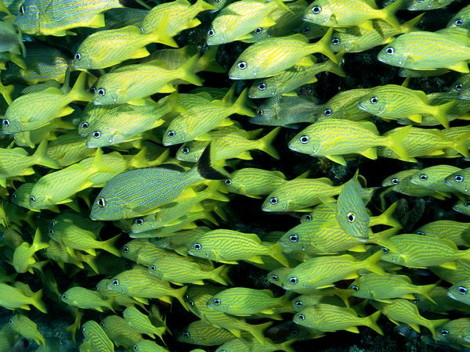
November 20th fish fill the seas
Notes:
By the 20th Fish fill the seas

Slide 14
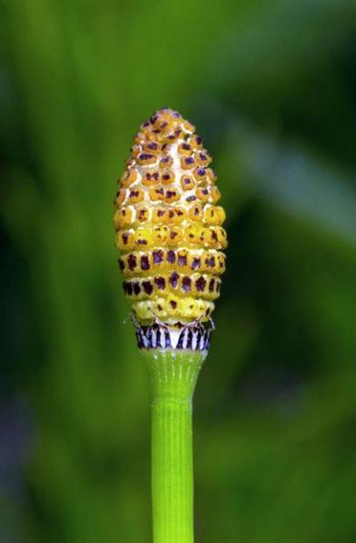
November 22nd plants evolve on land
Notes:
Green plants arrive Nov 22

Slide 15
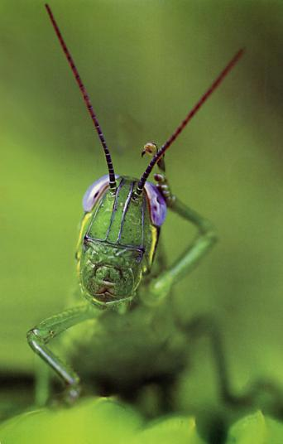
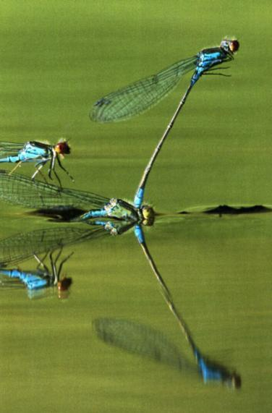
November 24th insects evolve
Notes:
By the 24th, insects and other invertebrates begin to roam the soil

Slide 16
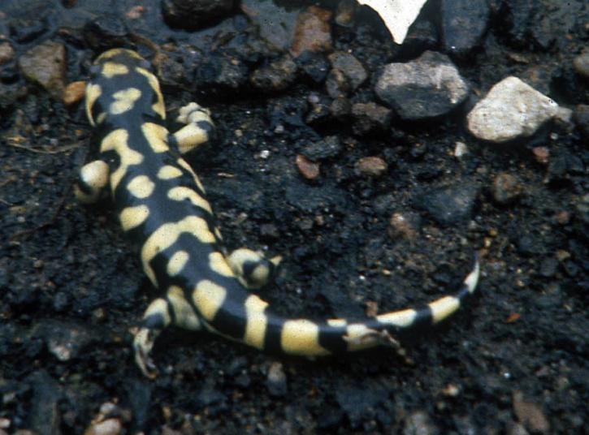
December 2nd
amphibians evolve
Notes:
Dec 2 – amphibians
Like our tiger salamander

Slide 17
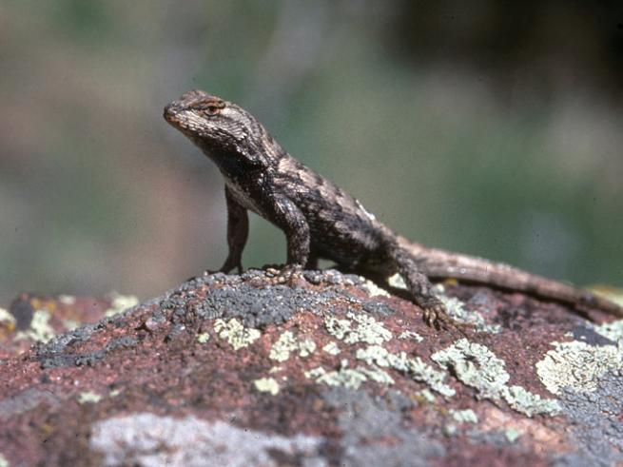
December 6th
reptiles evolve
Notes:
Dec 6 reptiles arrive.
So successfully that they ruled the planet for 350 million years!

Slide 18
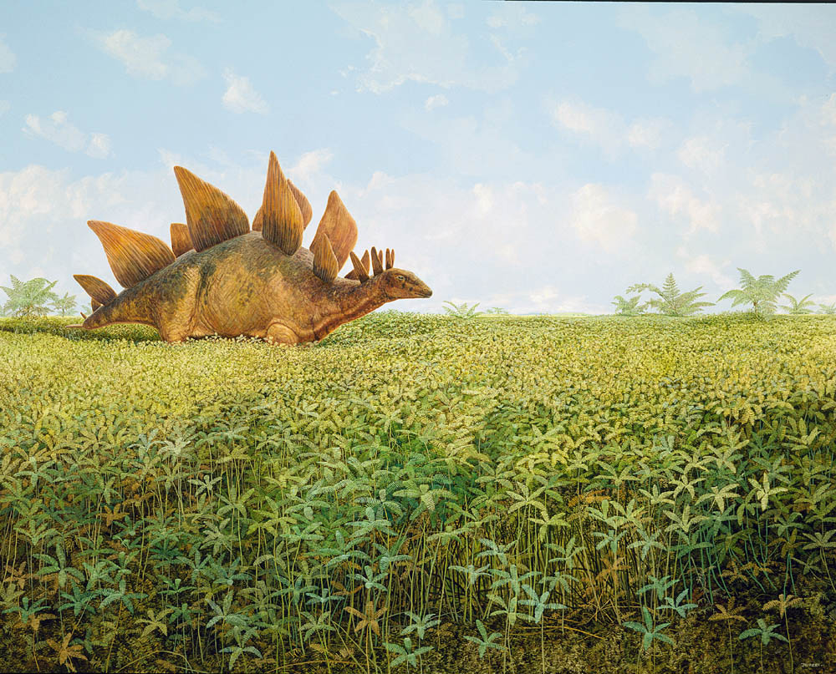
Notes:
Dinosaurs wander the landscape we now call Boulder
Stegosaurus
Jurassic period corresponds to Morrison formation

Slide 19
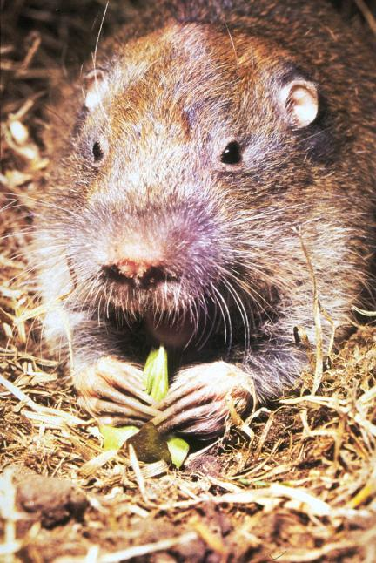
December 13th
mammals evolve
Notes:
Dec 13 mammals

Slide 20
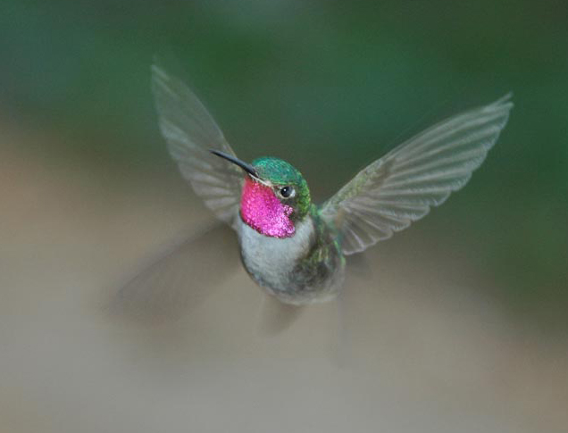
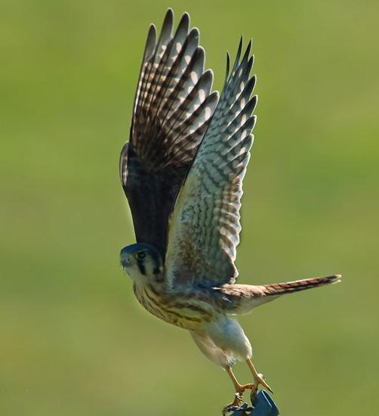
December 18th
birds evolve
Notes:
Dec 18th birds
Male Broad-tailed Humming bird @ Greg Joder
Kestral @Dan Baldwin

Slide 21
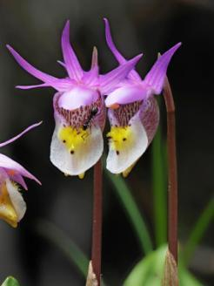
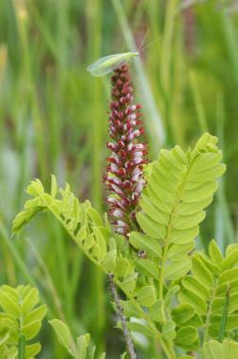
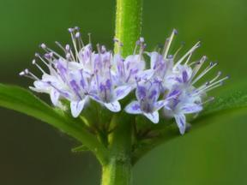
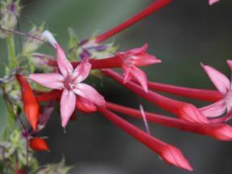
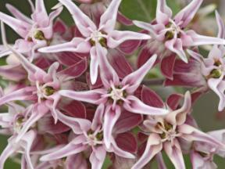
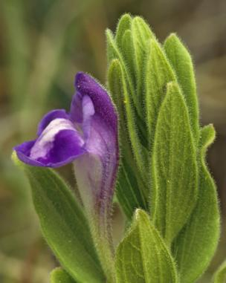
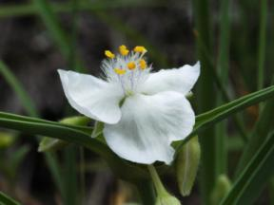
December 20th flowers evolve
Notes:
Flowers arrive just in time for winter solstice.

Slide 22
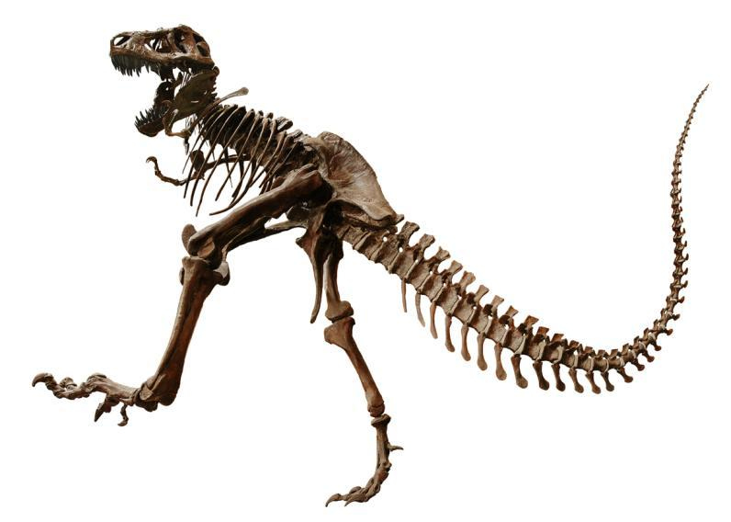
December 25th dinosaurs go extinct
Notes:
Dinosaurs go extinct on Christmas Day.
Dec 25 6:30 pm dinos extinct

Slide 23
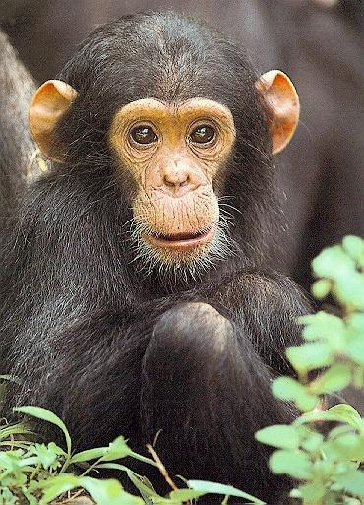
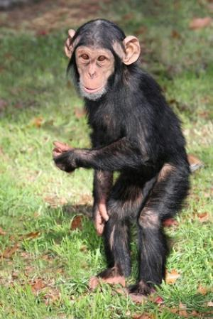
December 31st, 11:30 AM the hominids evolve
Notes:
Just 12 and a half hours ago, our predecessor arrived
At 11:30 am on Dec 31st our ancestors, the hominids, the first two-legged walkers arrived

Slide 24
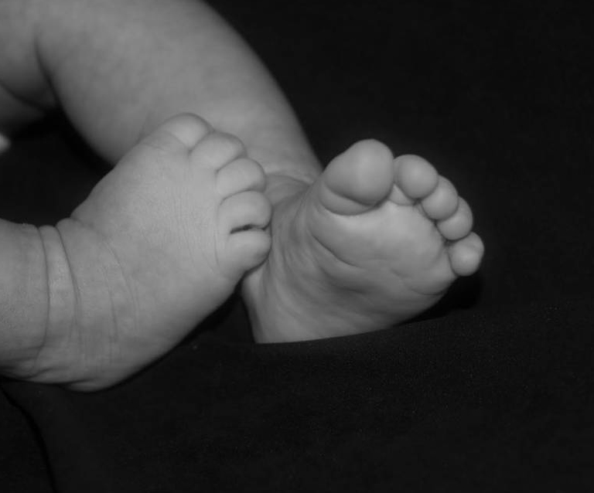
December 31st, 11:36 PM humans evolve
Notes:
Just a few minutes before midnight humans arrive! We are the young ones,
and we have a lot to learn.
Luckily we are also curious and capable.
How we live in this lifetime will shape our fate on Earth as a species. Will we be sturdy survivors? Or another layer of dust on the pile of extinction, joining the 99% of all species who tried to make it here, but failed.

Slide 25
Notes:
I hope we can live up to our species' full potential - using our intelligence, imagination and abilities to create a sustainable future, in a sustainable city, in community with our wild mentors.
Biomimicry is about remembering to listen and learn from these elders. They have been involved in a 3.8 billion year research and development stint. We would be smart to tune in, as they hold the key to success, the 1% of those species who have survived here.
If we apply our curiosity and relax our knowing for a while we’ll have a better chance of joining the circle of winners.

Slide 26
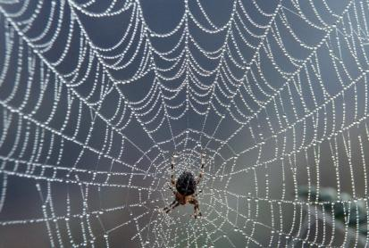
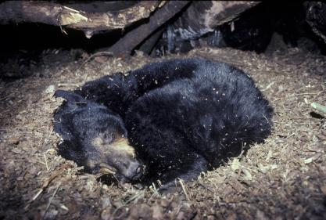
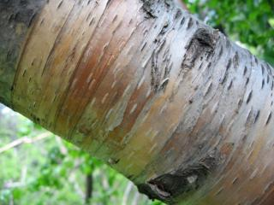
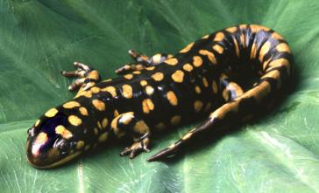
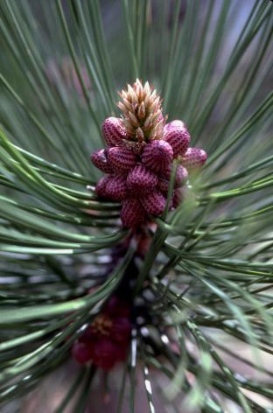
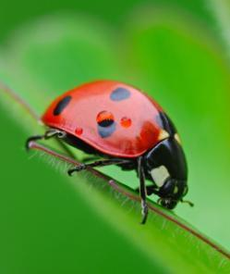
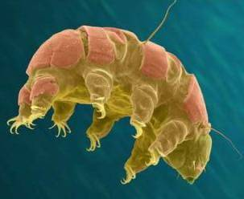
Notes:
Some of these elders we’ve seen today have already guided us, let’s turn our full attention to those who remain. Who will be your role model?
Paper birch @ Doug Goodin

Slide 27
Biomimicry Process
Assemble a multi-disciplinary team
Engineer, Biologist, Designer, Architect, Planner
Identify the problem and its context
Research how nature solves that problem
Define the design concepts behind nature’s solutions
Brainstorm multiple human applications reflecting nature’s solutions
Test those applications, ensuring that they adhere to all of Life’s Principles
Notes:
ID multi-disciplinary team: Engineer, Biologist, Designer, Architect, Planner
Identify the problem and its context
Research how nature solves that problem
Articulate the core design concepts behind nature’s strategies
Brainstorm multiple solutions
Test those solutions, ensuring that they adhere to the 6 Life’s Principles
Identified and defined by the Biomimicry Guild
as….

Slide 28
Life’s Principles
Be resource (material & energy) efficient
Adapt to changing conditions
Be locally attuned and responsive
Use life friendly chemistry
Integrate growth and development
Evolve to survive
Notes:
By using Nature’s basic life principles we know our approach will work, because all surviving species have succeeded with strategies that all reflect these guidelines. We are part of the Earth’s system, not independent from it, so the intentional use of these guidelines will increase our chances of survival as well.

Slide 29
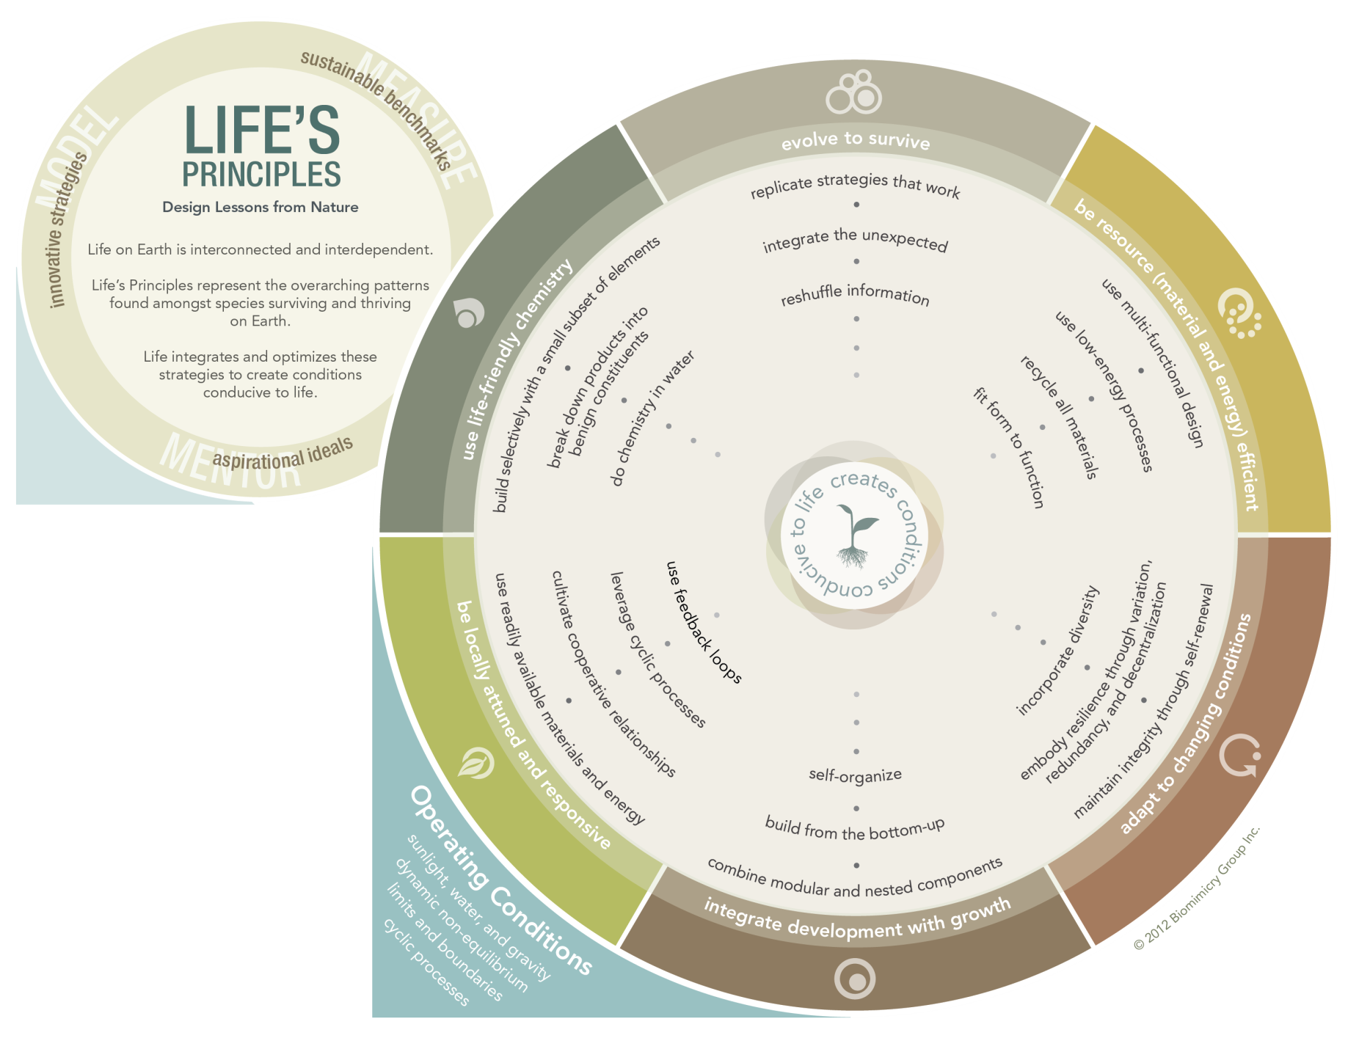
Life’s Principles
http://biomimicry.net/about/biomimicry/lifes-principles/
Replicate Strategies That Work
Notes:
The Life’s Principle wheel is a helpful diagram that includes all of the life’s strategies arranged into broader categories of the 6 Life’s Principles. The link to the web diagram is in the upper right corner. Let’s take a look at the strategies as they align with the Life’s Principles in a little more detail…

Slide 30
Examples of Life’s Principle’s Strategies
Be locally attuned and responsive
use readily available materials and energy
cultivate cooperative relationships
leverage cyclic processes
use feedback loops
Adapt to changing conditions
maintain integrity through self-renewal
embody resilience through variation, redundancy, and decentralization
incorporate diversity
Notes:
Each of these principles incorporates a number of strategies, here are a few to illustrate these concepts:
----------------------
Here are all of the principles and their strategies for your reference:
EVOLVE TO SURVIVE
replicate strategies that work
integrate cyclical processes
reshuffle information
BE RESOURCE (MATERIAL AND ENERGY) EFFICIENT
use multi-functional design
use low energy processes
recycle all materials
fit form to function
ADAPT TO CHANGING CONDITIONS
maintain integrity through self-renewal
embody resilience through variation, redundancy, and decentralization
incorporate diversity
INTEGRATE DEVELOPMENT AND GROWTH
combine modular and nested components
build from the bottom up
self-organize
BE LOCALLY ATTUNED AND RESPONSIVE
use readily available materials and energy
cultivate cooperative relationships
leverage cyclic processes
use feedback loops
USE LIFE FRIENDLY CHEMISTRY
build selectively with a small subset of elements
break down products into benign constituents
do chemistry in water

Slide 31
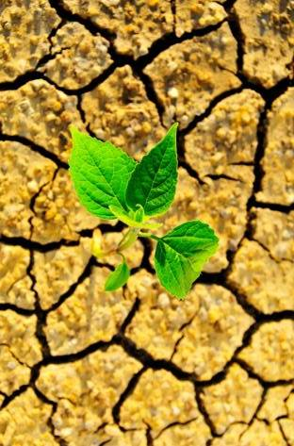
How does nature?
How does nature
adapt to change?
Notes:
Our team chose to look at how nature adapts to seasonal change and
to climate change and, how can this inform Front Range communities
NOAA and NCAR scientists project local effects of climate change to include: more extreme heat events and year round warming, more precipitation falling as rain rather than snow, diminished the snow pack and water supply to reservoirs, earlier spring melts, and the possibility of less precipitation overall with more intense precipitation events, longer and more intense drought.

Slide 32
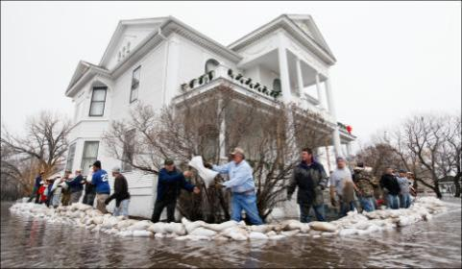
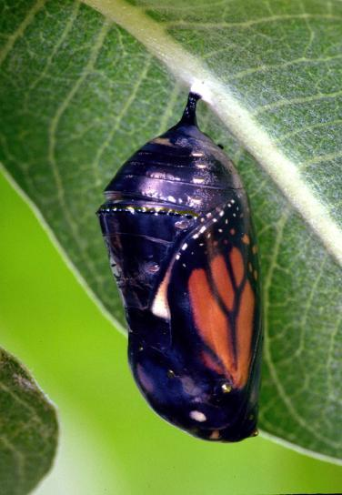
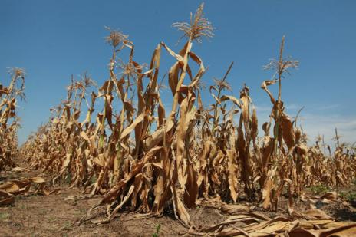
How does nature?
Photo: Shotaku
Photo: Bill May
Notes:
affecting water availability, including to local ranchers and farmers.
However, there may also be more extreme precipitation and flooding events
Collectively a lot to think about… so we chose to simplify our question to

Slide 33
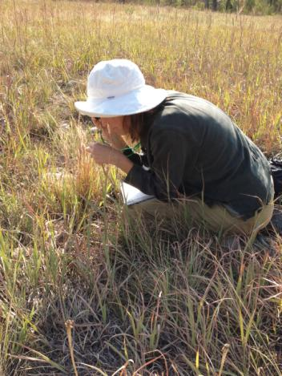
Discovering Nature’s Strategies
Go out into nature
to observe strategies and relationships
Notes:
direct observation of nature, holding specific questions about how nature works, or simply opening our perceptions to what we can see, smell, hear, feel or intuit from our surroundings is very informative, for example…

Slide 34
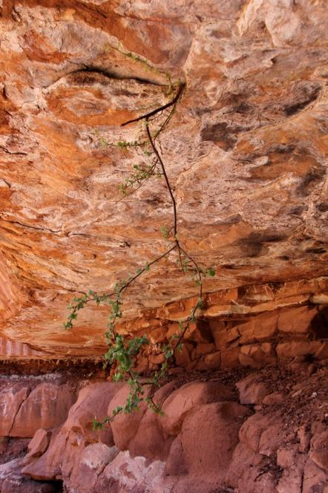
Direct observation
Gravity shmavity….
Notes:
Who would have thought of this? a tree defying gravity, growing from the roof of an overhang
Really?!- but it’s working! just because we think it’s impossible doesn’t mean it is.
The most important lesson here is that Nature reminds us that we are well served to suspend our knowing minds, in order to open to our sense of wonder, and expand our perceptions to what is actually possible. In this way we can see a much broader spectrum of potential solutions to the challenges we face.

Slide 35
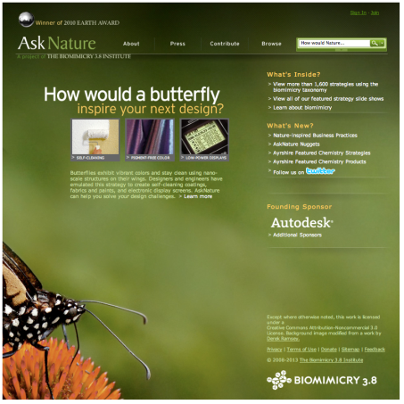
Discovering Nature’s Strategies
Can anyone figure out how to import the face page from asknature.org to go next to the text to the left?
AskNature.Org
and
Scientific Literature
Notes:
Simultaneously the practitioners delve into the strategies that scientists have identified in scientific literature and through a great website created by the biomimicry guild, called AskNature.org, that allows one to search any question, How does nature do….. The site contains an extensive compilation of information, doing much of the research for us.
So here is what we found as we honed in on the question, “How does nature deal with water - considering the full spectrum from extreme precipitation events and flooding to drought?”

Slide 36
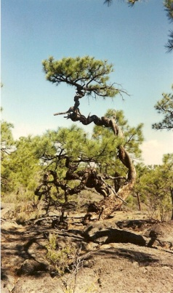
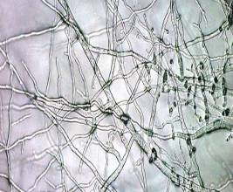
How does nature
deal with drought?
Photo credit: H.D. Grissino-Mayer
Notes:
Our examples are taken from species found here in the Front Range because they are already adept at thriving in a hot, dry climate.
In our first example we chose the symbiotic relationship between the ponderosa pine tree and soil fungi. The fungi’s extensive network of fine roots spread throughout the soil drawing water and nutrients to the tree’s more limited root system, as well as storing water in tiny but innumerable reservoirs within the root network for drier times. In return, the tree provides food for the fungi and during droughts actually draws moisture held in the deeper soils up towards the surface, making it accessible to the fungi and therefore all the plants that are connected into the fungal network, which is the vast majority of plant species.
But it doesn’t stop there, the fungi, which are symbiotically connected with about 90% of plant species, also convert nitrogen into a form more accessible to the plants, and produce helpful hormones and antibiotics .They also enrich the soil with organic matter and improve air and water flow into the soil by clumping it together with sticky glue-like substances.
ADD PHOTO

Slide 37
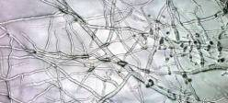
How does nature deal with drought?
SPECIES and STRATEGY | LIFE’S PRINCIPLES | HUMAN APPLICATION | POLICY ISSUES or IMPLEMENTATION BARRIERS
Ponderosa Pine and Fungi Living cooperatively the fungi and the tree access and share water beyond one another's’ reach. | Cultivate cooperative relationships Be Locally Attuned and Responsive Evolve to survive Embody resilience through redundancy and decentralization Replicate strategies that work | Use available water more efficiently | Water rights: use it or lose it Municipal development codes
Use a variety of means and locations to store water
Photo- H.D. Grissino-Mayer
Notes:
the Life’s principles embodied in this relationship include: [read the list]
The next step is to apply the species’ strategies and the related Life principles to human systems. [read the “Human Application” column]
However, there may be implementation barriers to overcome, like local water law, but considering the gravity of the projected changes to our climate and the potential extreme challenges accompanying those changes, it seems we should continue to explore the wide range of solutions illustrated in these natural systems.
So, considering the Life’s Principles of “Replicating strategies that work” and “Embodying resiliency through redundancy and decentralization” we can come up with infrastructure that helps capture rain and mitigate storm water runoff.
Life’s Principles explained (those that aren’t obvious):
Replicate strategies that work – more than 90% of land plant speices have some sort of symbiotic relationship with soil fungi

Slide 38
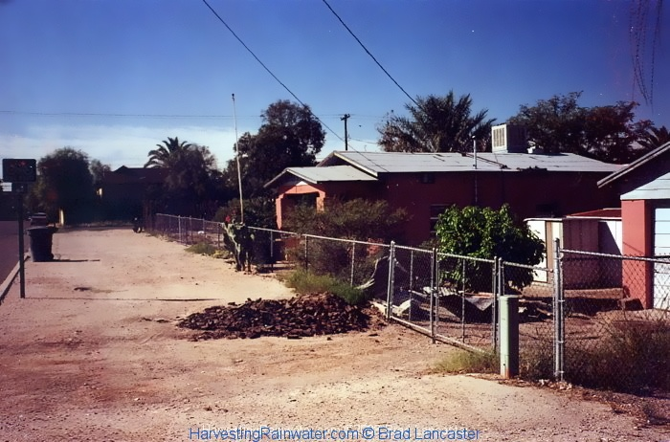
How does nature deal with drought?
Before
Notes:
Here’s a great example of the difference a rain garden can make in a parched climate, like Tucson AZ. This formerly barren, strip of land between these houses and the street was converted to this

Slide 39
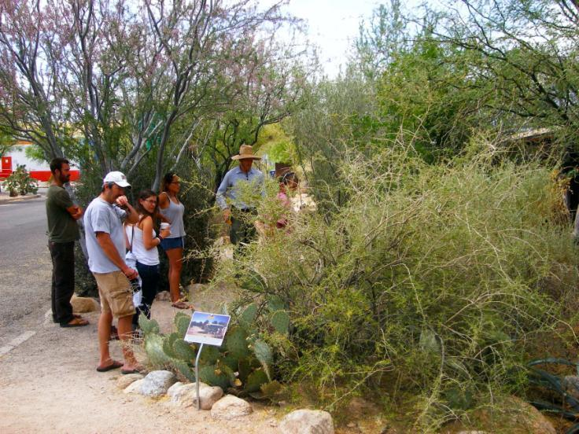
How does nature deal with drought?
Photo – Jason Gerhardt
After
Notes:
by simply cutting a gap in the curb to allow precipitation to move from the street to the soil. The result is constructive use of water that typically would have simply evaporated before reaching a stream. Now this forest of local native plants not only helps with storm water runoff but it also provides cooling shade and food for the humans and wildlife of the neighborhood.
This was Brad Lancaster’s idea, the man in the middle of the picture with a blue shirt and tan hat. The problem was that it wasn’t legal to cut the curb and pull the water off of the street. However, after many long and frustrating conversations, city officials finally realized it served everyone‘s best interest to follow Brad’s lead. Now Tucson owns a large machine that cut curbs spreading the capacity city-wide for people to more productively harvest rain water.

Slide 40
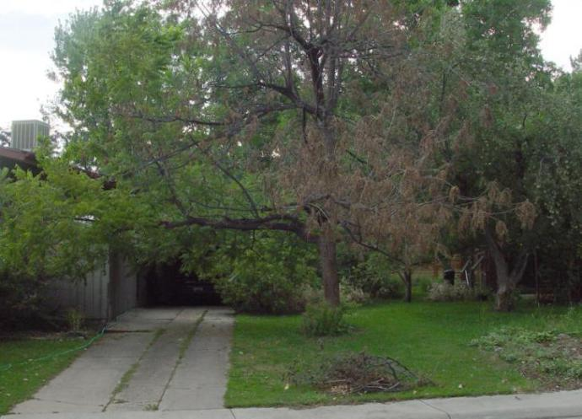
How does nature deal with drought?
Photo – Jason Gerhardt, Real Earth Design, Permaculture Landscapes & Education
Before
Notes:
Jason Gerhardt of Real Earth Design transformed this landscape, with a dying black walnut to

Slide 41
How does nature deal with drought?
Photo – Jason Gerhardt, Real Earth Design, Permaculture Landscapes & Education
Notes:
To this permaculture garden simply by redirecting water flowing from the house gutter - the black pipe on the left

Slide 42
How does nature deal with drought?
Photo – Jason Gerhardt, Real Earth Design, Permaculture Landscapes & Education
After
Notes:
In doing this a beautiful native garden flourishes and re-directs, slows and spreads water flow helping to reduce peak flow during storm water run off.

Slide 43
Drought strategies help with flooding
Street and home-fed Rain Garden
Roof-fed Cistern
Cooper Center for Environmental Learning , Tuscon, AZ
System and photo by
Technicians for Sustainability, LLC
Notes:
Some of the same strategies that are useful in drought also are beneficial during times of flooding as well.
Rain gardens (also known as bioretention or bioinfiltration cells) are shallow, vegetated basins that collect and absorb runoff from rooftops, sidewalks, and streets. Rain gardens mimic natural hydrology in the cityscape by allowing runoff water to more broadly infiltrate soil and be absorbed by vegetation, helping to mitigate flood waters, while simultaneously storing water in a natural system.
Rain gardens are versatile features that can be installed in almost any unpaved space, when coupled with other strategies, like roof-fed cisterns, we replicate the successful strategies of redundancy and decentralization, WHEN we implement these systems city-wide.

Slide 44
How does nature deal with water?
SPECIES and STRATEGY | LIFE’S PRINCIPLES | HUMAN APPLICATION | POLICY ISSUES or IMPLEMENTATION BARRIERS
Trench beetle creates a trench to collect water | Be Locally Attuned and Responsive Evolve to survive Embody resilience through redundancy and decentralization Replicate strategies that work | Stormwater Tree Trenches Pervious pavement and parking lots | Water rights: use it or lose it Municipal development codes
Leaves of cactus capture water due to their fan-shaped arrangement and curved shape.
Notes:
Nature collects water everywhere, especially where it is most valuable. How species survive in dry habitats can provide inspiration for humans dealing with both drought and flooding. For example the trench beetle digs a trench, leaving a ridge that intercepts moisture laden air passing by. Water condenses on the ridge and moistens the sand, where the beetle collects it.
In another case, the leaves of this cactus, redirect and concentrate water flow into the ground straight towards the taproot of the plant, which has excellent capacity to capture and store the water. Many cactus also have readily expandable leaves or a barrel shaped body that can rapidly absorb water when it becomes available.
Maybe we can use some of these strategies to help us with heavy precipitation events.
Life’s Principles explained (those that aren’t obvious):
Embody resilience through redundancy and decentralization – the cactus can have multiple places to store water, in root system, expandable leaves or expandable trunk, depending on the species.
Replicate strategies that work – many leaves funnel more water to root system than just a few would. Most cactus species have evolved the strategy of protecting their water resources with spines.

Slide 45
How does nature deal with extreme
precipitation and flooding?
Credit: Wayne Hsieh
Notes:
So, how does nature deal with extreme precipitation and flooding? Historically a very real concern that is getting worse with the changing climate.
In the photo on the right, an SUV lies submerged in downtown Nashville, Tennessee, after a massive rainstorm in May 2010 overwhelmed the flood controls for the area. 14 inches of rain fell over two days — more than twice as much as had ever fallen in a two-day span in the city’s recorded history. This event caused $30 billion in damage and killed 30 people. (“When It Rains It Pours” – Environment America – 2012)

Slide 46
How does nature deal with flooding?
Notes:
Over the 100 year period charted in this graph you can see an increase in the occurrence of extreme 1-day precipitation events across the country. A warmer atmosphere can hold more water leading to more frequent record precipitation events (from NOAA Climate Extremes Index).
In the last 60 years, extreme downpours, rainstorms and snowfalls that are among the largest experienced at a particular location have become 26% more frequent in the Mountain West, and 85% more frequent (or almost twice as likely ) in New England.
Not only are extreme downpours more frequent, but they are also more intense. In the last 60 years, the total amount of precipitation produced by the largest storm in each year at each station increased by 8 percent in the Mountain West, but by 26% in New England (When It rains, It Pours – Environment America – 2012).
So, it would behoove us to learn how nature deals with flooding events.

Slide 47
How does nature deal with flooding?
SPECIES and STRATEGY | LIFE’S PRINCIPLES | HUMAN APPLICATION | POLICY ISSUES or IMPLEMENTATION BARRIERS
Entrances to ant nests are protected from flooding by collapsing and blocking the opening Entrances to the underground burrows of prairie dogs are protected from flooding by circular dikes to divert water. | Be Locally Attuned and Responsive Build selectively with a small subset of elements Fit form to function Use multifunctional design Use low energy processes | After Hurricane Sandy, New York City building owners are installing seals and flood barriers for key electrical and mechanical equipment Protect critical infrastructure in floodplains with berms or.. | Obsolete flood plain maps Judging future risks in new climatic conditions Spending limited funds on hard to predict risks
Notes:
Read the species and strategy and Life’s Principles sections
Read the Human applications section

Slide 48
How does nature deal with flooding?
SPECIES and STRATEGY | LIFE’S PRINCIPLES | HUMAN APPLICATION | POLICY ISSUES or IMPLEMENTATION BARRIERS
Peatlands slow down water flow in wet conditions and release it in dry conditions. They also clean the water of pollutants and silt | Use multi-functional design Combine modular and nested components Maintain integrity through self-renewal Cultivate cooperative relationships | Bio-swales Green stormwater infrastructure Rainwater harvesting – cisterns Rain gardens Green roofs | Water rights: use it or lose it Municipal development codes
Notes:
In another examples, peatlands and other types of wetlands not only slow water flow during flooding and slowly release it during drier times, but they also clean the water of pollutants and silt.
Life’s Principles explained (those that aren’t obvious):
Use multi-functional design – SLOWS RELEASES AND CLEANS WATER
Combine modular and nested components – modular component = is responsive to the varying conditions, such as drier times or flood events. the nested components allows for the structure that supports the continuation of life, the physical variation in the changing microlandscape of the wetland
Maintain integrity through self-renewal – a seed bank exists in the soil, waiting during drier times for the water to return, so that there is very little delay in plant growth response and no time required for succession to rebuild the plant biodiversity, which helps to mitigate the flooding events
Cultivate cooperative relationships– between the abiotic water supply or lack thereof, and the biotic response of the plants to either grow with water or to be dormant as seeds within drought times
Let’s look at some of the Human Applications being put into place or being hypothesized [next slide]

Slide 49
How does nature deal with flooding?
Notes:
on a small scale this tree trench captures stormwater, reduces peak storm flows, purifies stormwater, and provides irrigation for trees. With implementation throughout a city we can begin to mimic the capacity of a peatland to mitigate flood waters. Trees also capture rainwater, provide urban cooling, and improve aesthetics, air quality, and property values.
These are being implemented all over the country including Denver and Philadelphia.

Slide 50
EPA Region 8’s Green Roof, Denver, CO
Compared to a conventional roof
the green roof is:
has significantly higher storm-water retention
cooler during hot weather
warmer during cold weather
The EPA Region 8 Headquarters’ green roof with study plots and instrumentation. The solar panels provide beneficial shade during hot weather. Photo: EPA Region 8.
Notes:
The EPA has created an excellent research study with it’s green roof on the Region 8 Headquarters building located in Denver, CO. They are comparing it’s thermal and water management characteristics against a conventional roof.
Not only does it have significantly higher storm-water retention,
results show that the green roof is cooler during hot weather and warmer during cold weather because the plant materials and growth medium enable thermal storage and evaporative cooling as moisture transitions between liquid, vapor and solid physical states.
If this were to be implemented city wide, we could begin to offset the runoff and heating caused by roof tops citywide with a cooling absorbing artificial landscape.

Slide 51
How does nature deal with flooding?
Philadelphia’s Green Infrastructure Goals
Notes:
Philadelphia's green stormwater infrastructure, Components include natural water storage and filtering solutions such as rain gardens, bio-swales, tree trenches, curbside planters and green rooftops. Similarly, porous asphalt, concrete and paving slabs will also be installed in parking spaces and on streets.

Slide 52
How does nature deal with flooding?
Bioswales from
Lake County, Illinois
Notes:
Here are pictures of bioswales
Philadelphia's proposed green stormwater infrastructure improvements seen on the previous slide could cost up to $2 billion. Seems like a lot of money, however, a traditional separated storm sewer system has been estimated to cost up to $8 billion.
Moving from flooding to high temperatures, let’s consider the prairie dog again [next slide]

Slide 53
How does nature deal with high temperatures?
Notes:
The prairie dog’s home is an underground burrow. The earth’s temperature keeps the burrow cooler in the summer and warmer in the winter, compared to the ambient temperature. It is also self ventilating

Slide 54
Notes:
With two openings, one located higher than the other, there is a natural air flow through the borrow, making summer time temperatures even more comfortable for the inhabitants. So which Life’s Principles are at work here?

Slide 55
How does nature adapt to high temperatures?
SPECIES and STRATEGY | LIFE’S PRINCIPLES | HUMAN APPLICATION | POLICY ISSUES or IMPLEMENTATION BARRIERS
Black-tailed Prairie Dogs Burrow temperature regulated by the earth’s subsurface temperature and ventilated passively by air flow through the tunnel | Be Resource Efficient Use multifunctional design Harness freely available energy Use low energy processes Fit form to function Build with accessible materials | Access the earth’s relative coolness and warmth to cool and heat our buildings through eothermal building design Use passive ventilation for cooling of buildings Build with straw bales | Current building codes Not a common practice Consider life-cycle economics of buildings
Photo Frank Beck
Notes:
Read the life’s Principles
Read the Human applications could include passive ventilation building designs [next slide]

Slide 56
Notes:
Here is a building design that takes advantage of passive ventilation.
As we’ve seen today, in these few examples of how species and systems deal with drought, flooding, and high temperatures, there are great strategies out in nature to be discovered, and the time is ripe for us to find solutions to an increasing number of related problems.
And [next slide]

Slide 57
Geothermal Design
Notes:
Geothermal designs

Slide 58
Nature's genius has excellent references for the job of being our mentor.
Image Credit--JEFF JOHNSON Hybrid Medical Animation
http://www.youtube.com/watch?v=FnSxRYx82Gk
Notes:
For example, the motor is widely thought to be a uniquely human invention, however, thousands of years before humans even appeared on Earth, bacteria developed a flagellum motor, which has the characteristics of an electric motor, to propel itself through water. Follow this link to a fascinating short video, describing the bacterium’s capacity.

Slide 59
Nature as Mentor
Notes:
The ultimate message is that the very prairie, mountains and streams along the Front Range (or surrounding Boulder) are home to very potent mentors, elders who contain a store house of information gleaned over 3.8 billion years of evolutionary research and development of life on earth. Most species have failed into extinction. In that light, the value of learning from the surviving species and natural systems is magnified many fold. By investing in the Biomimicry process, and using Life’s Principles and strategies as our guiding directives, we will be better informed and prepared not only survive, but to thrive within our changing environment. Becoming good neighbors to all of the Earth’s species.
[Inventions nature’s vs people’s how all of our basic inventions are reflected in strategies nature came up with long ago??? Incorporate this…]

Slide 60
What problems do you have to solve?
Wildland fire and drinking water management as related systems
Water storage in an arid environment
Etc.
Notes:
This would open the conversation into the specific issues relevant to that audience

Slide 61
Biomimicry 3.8 Contact information
Nicole Miller
Director of Consulting and Client Services
Nicole.miller@biomimicry.net
Phone: 406 543-4108 X 234
HTTP://WWW.Biomimicry.net
Notes:
Put this as the last slide. Contact information for anyone wanting to talk with the Biomimicry Institute, now called Biomimicry 3.8, for help.

Slide 62
How does nature deal with extreme heat?
Photo – Perry Conway
Notes:
Another animal that manages extreme temperatures is the Jack rabbit. Warm blood from the body circulates through large ears. The extensive surface area of the ear quickly dissipates heat to the environment, helping to keep the rabbit’s body temperature lower.

Slide 63
How does nature adapt to high temperatures?
SPECIES and STRATEGY | LIFE’S PRINCIPLES | HUMAN APPLICATION | POLICY ISSUES or IMPLEMENTATION BARRIERS
Jack Rabbit Ears cool rabbit as warm blood from body flows into ears with large surface area, allowing cooling directly to the environment | Be resource efficient Use multi-functional design Use low energy process Fit form to function | Use fluid flow between hot and cold surfaces to cool building Heat collectors for buildings raised for nighttime cooling | Building code limitations Modernization of standard building design
Photo – Perry Conway
Notes:
You can see the variety of Life’s Principles at play here as well as some of the potential applications for human systems.

