Slide 1

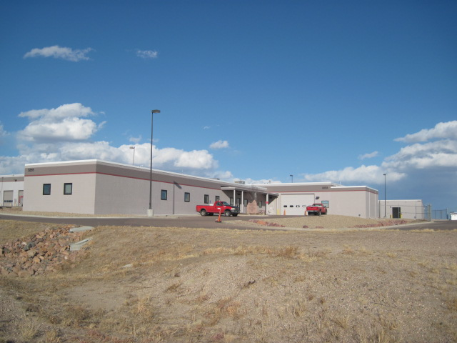
2014
Household Hazardous Waste Facility

Slide 2
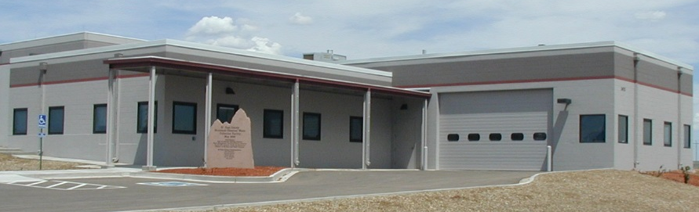
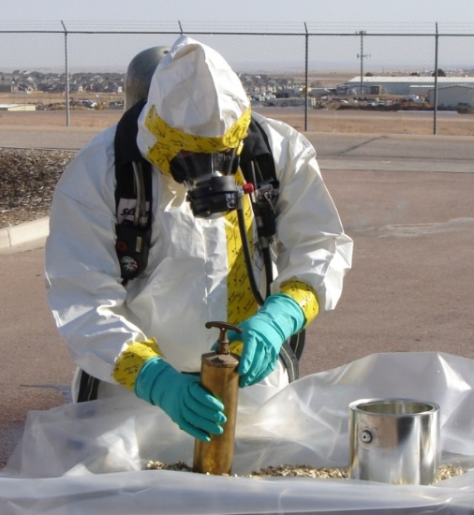
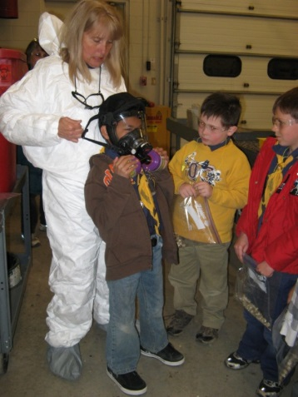
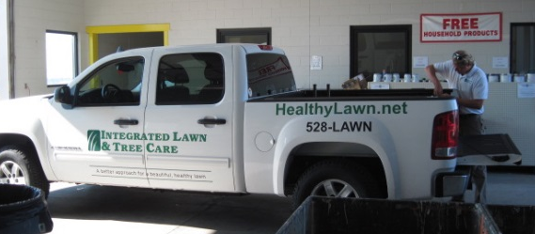
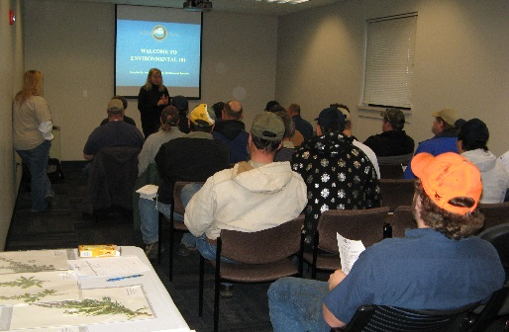
Household Hazardous Waste Facility
Opened in 2002
2014
Established by the County Commissioners
Funded by tipping fees from local landfills
Household hazardous waste exempt from RCRA
Free residential program for El Paso & Teller Co. citizens
Initially accepted 3 waste streams & served 256 customers
Building expansion completed in 2011
Additional space used for:
1. Expanded services
17 waste streams & served 20,170 customers in 2013
2. New programs
Conditionally Exempt Small Quantity Generator (CESQG) Program,
a fee-based program for commercial businesses
3. Environmental education
Tours and classroom training
Notes:
Speak to cost saving realized in by not filling management positions following consolidation of three departments.

Slide 3




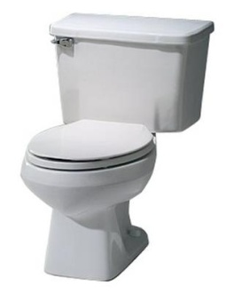
Household Hazardous Waste Facility
Residential Program
20,170 customers in 2013
El Paso & Teller County residents
Free
Commercial Program
144 customers in 2013
Qualifying El Paso & Teller County businesses
Fee-based
LANDFILL DIVERSION:
Chemicals Electronics Medicines Porcelain

Slide 4


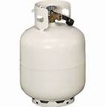




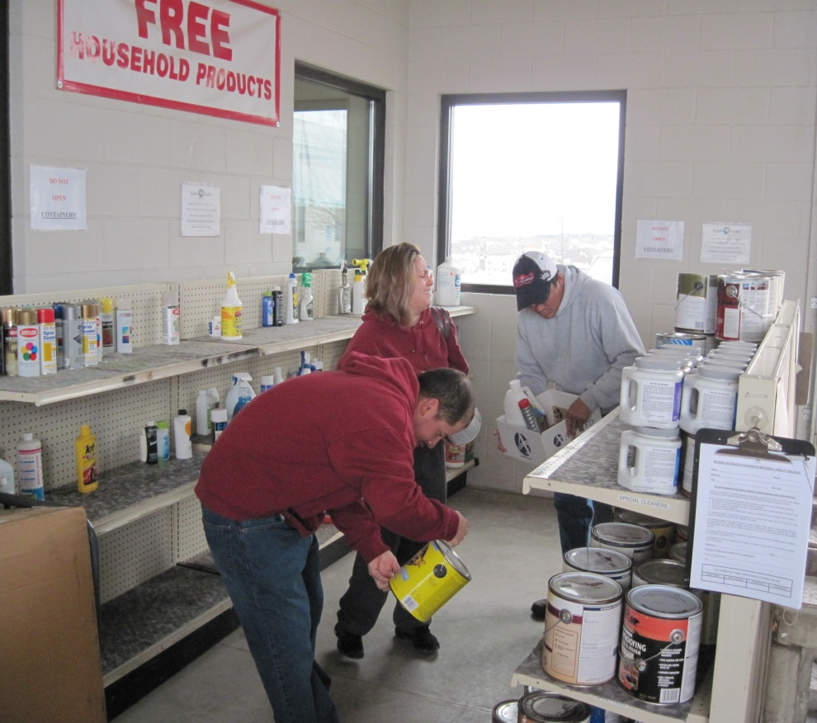
Chemicals
Free Drop & Swap Program
Given away in 2013 (approx.):
Paint 9,000 gallons
Household cleaners 6,000 quarts
Lawn & garden chemicals 4,000 pounds
Automotive products 3,000 quarts

Slide 5
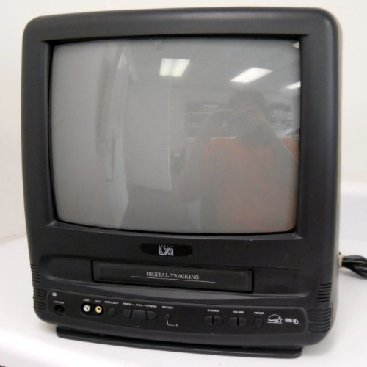
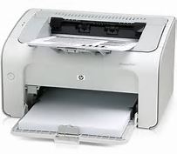
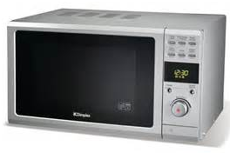
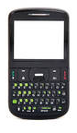

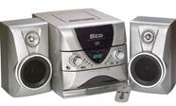

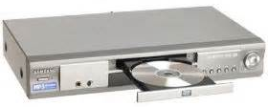

Electronics
Almost 1.5 million pounds collected since 2007
19” diagonal or smaller
Data Media
Over 5.5 tons collected since 2012

Slide 6

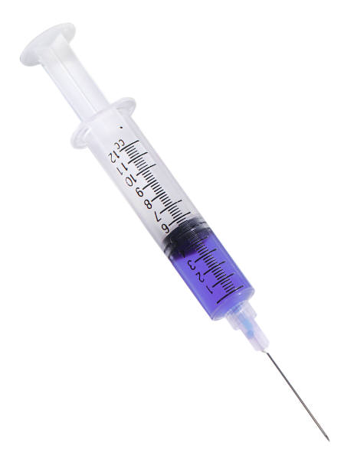


Medicines
Home-use medications and medical sharps only
No controlled substances accepted

Slide 7




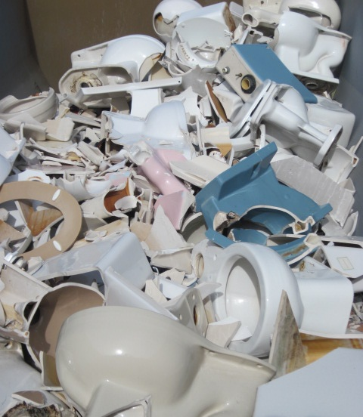
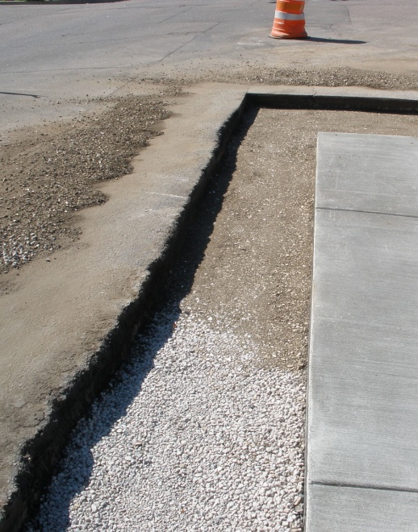
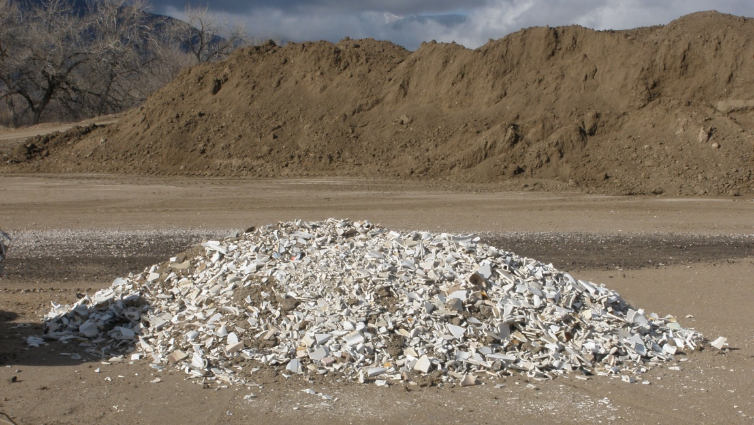
Porcelain Recycling
Saves landfill space
Partnership:
COLLECTED
USED IN ROAD PROJECTS
CRUSHED

Slide 8
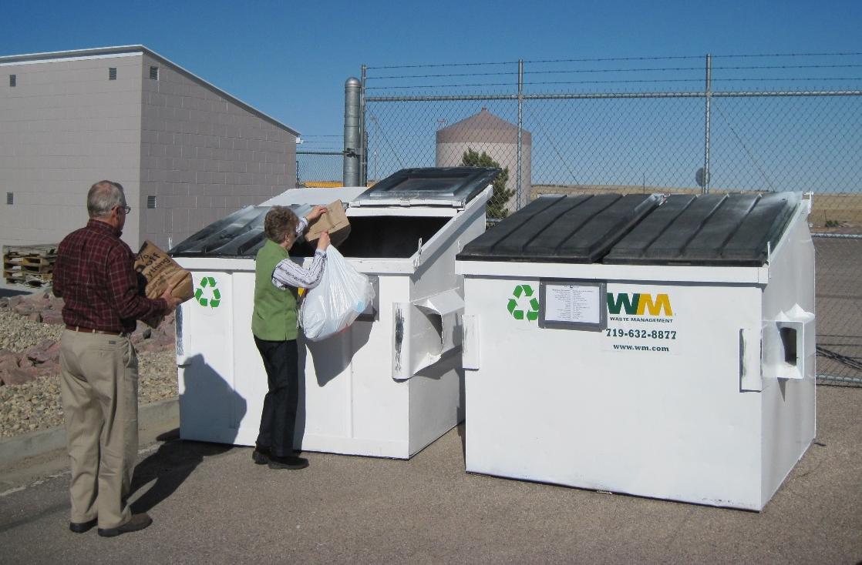
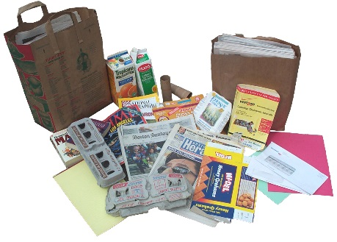


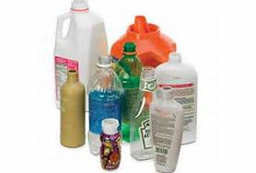
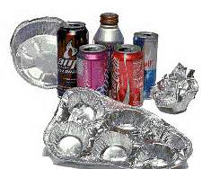

Single-Stream Recycling

Slide 9

Thank You!

